Slide 1


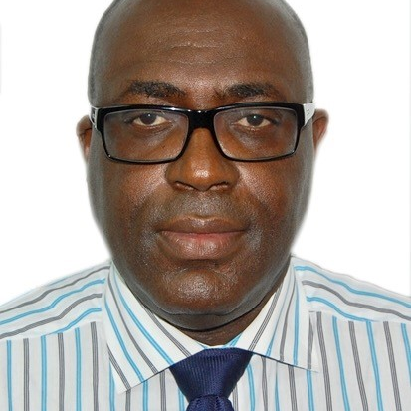
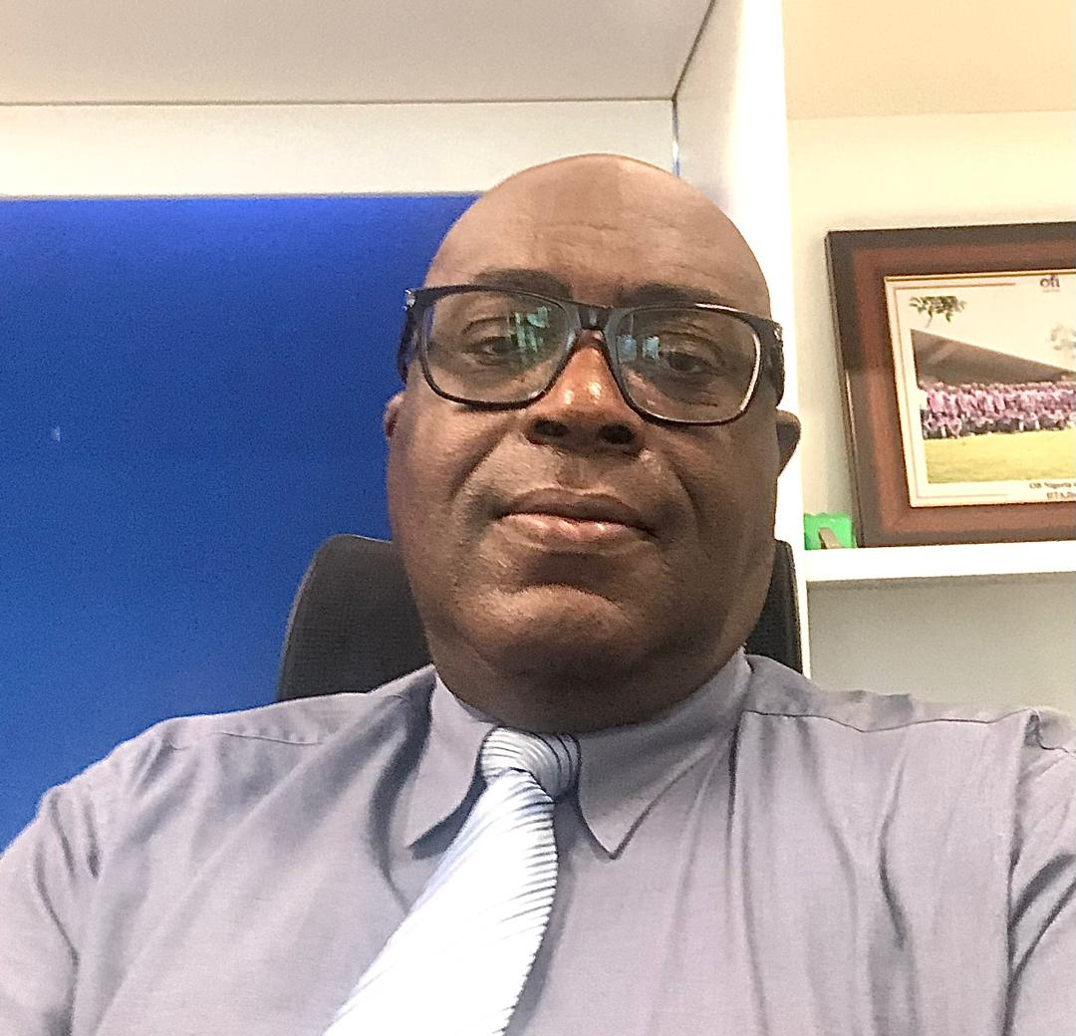
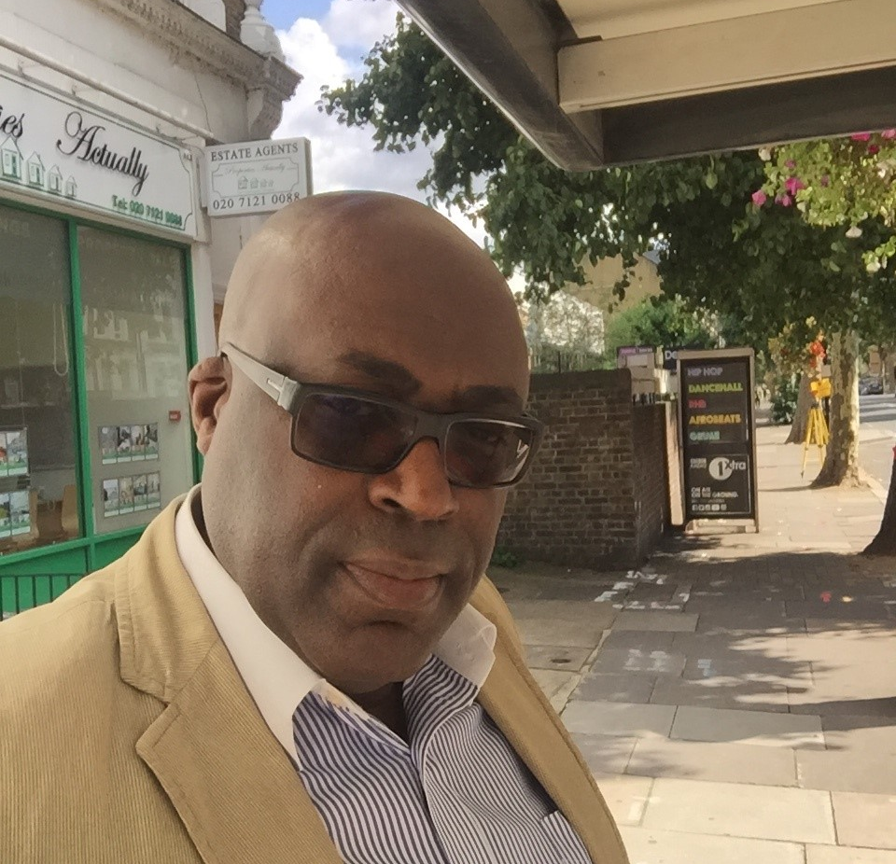
Getting to Know Me
Work
Personal
My role
Export Expansion Grant(EEG) Lead
Significant others / family members / furry friends in my life
Married with 4 Children
Tenure in ofi/Olam
14 Years
How I enjoy spending my free time
Taking long walks, watching live sports
Previous companies I have worked at
Ekaya Housing Association, London, UK
My favorite / comfort food
Coconut Rice
Why I joined ofi/Olam and what keeps me here?
New Challenge
My favorite song
Don’t Worry by Bob Marley
Churchill Eburajolo
‘what name you prefer to be called’
A few fun facts about me
An Avid Political Ethusiaist
This is me outside work, doing stuff I enjoy in my life …

